Slide 1
Network Architecture

Slide 2
Network Architecture
Netværks udstyr: Routere, switches, Access points
Hosts: Serverer, klienter
Segmentation: Subnets/VLANs
Specielle subnets: DMZ, Darknets
Sikkerheds udstyr: Firewall, IDS/IPS

Slide 3
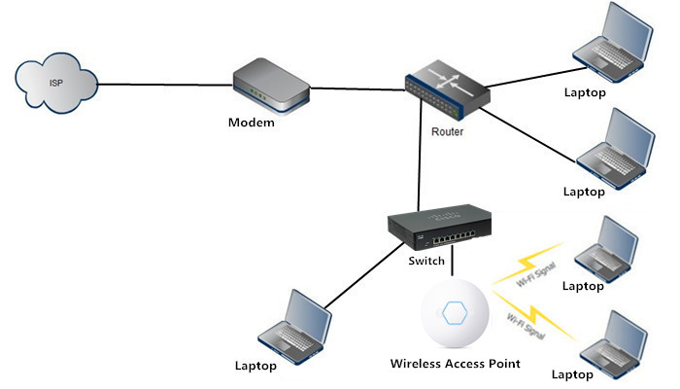
Routers, switches, Access points

Slide 4
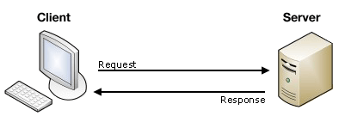
Serverer, klienter

Slide 5
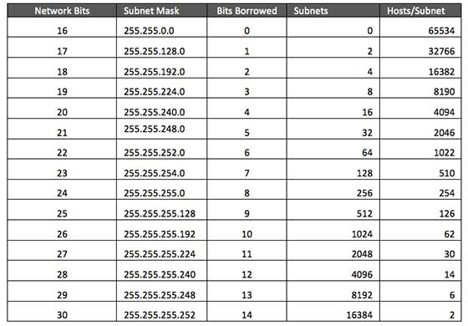
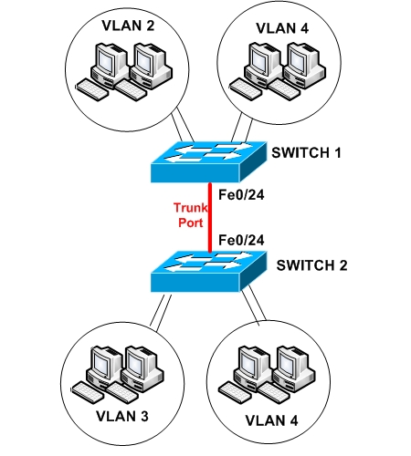
Subnets/VLANs

Slide 6
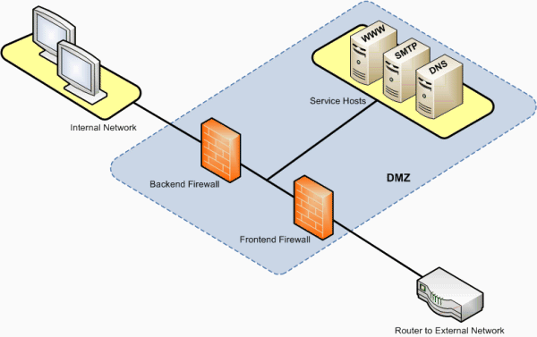
DMZ

Slide 7
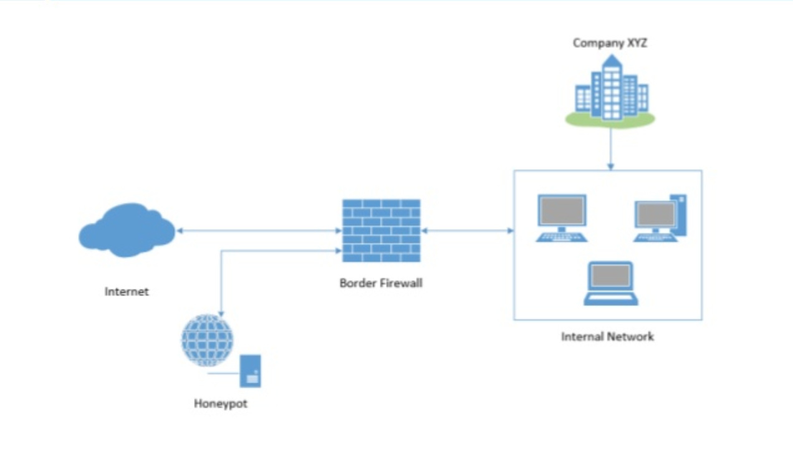
Darknets

Slide 8
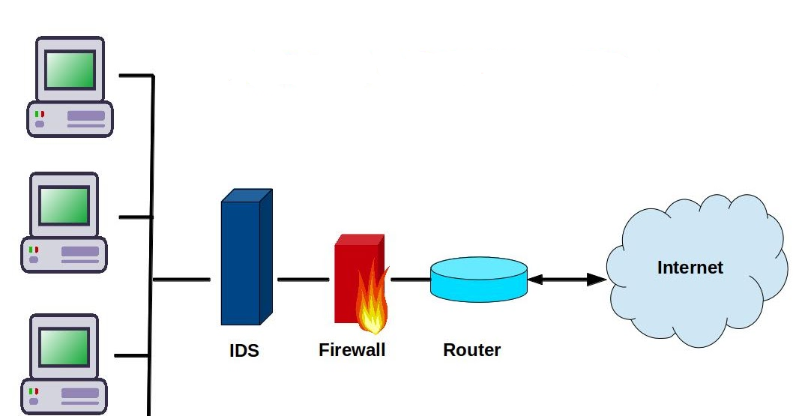
Firewall, IDS/IPS

